Slide 1

Neural Network Architecture and Activation functions

Slide 2
Network Architecture
Multiple layer
fully connected
Single layer
Unit delay
operator
outputs
inputs
Recurrent network
without hidden units
Recurrent network
with hidden units

Slide 3
Network Structure
Perceptron
This consists of a single neuron with multiple inputs and a single output. It has restricted information processing capability. The information processing is done through a transfer function which is either linear or non-linear.
2.Multilayered network
It has a layered architecture consisting of input, hidden and output layers.
Each layer consists of a number of Neurons. The output of each layer is transmitted to the input of nodes in other layers through weighted links. Usually, this transmission is done only to nodes of the next layer, leading to what are known as feed forward networks
3. Recurrent network
RNN topology involves backward links from output to the input and hidden layers. The notion of time is encoded in the RNN information processing scheme. They are thus used in applications like speech processing where inputs are time sequences data.

Slide 4
Feed forward networks (SLP & MLP ):
  Information only flows one way
  One input pattern produces one output
  No sense of time (or memory of previous state)
Recurrency
  Nodes connect back to other nodes or themselves
  Information flow is multidirectional
  Sense of time and memory of previous state(s)
Biological nervous systems show high levels of recurrency

Slide 5
Linear and Non Linear Activation Functions
To make the work more efficient and to obtain the exact output some force and activation may be given. This activation helps in achieving the exact output. The activation function is applied over the net input to calculate the output of an ANN
Information Processing consist of two parts
Input
Output
The integration function is associated with the input of a processing element. This function serves to combine activation, information into a net input to the processing element
The nonlinear activation function is used to ensure that actual response of neuron is bounded i.e. conditioned

Slide 6
Activation functions for the hidden units are needed to introduce nonlinearity into the network
Without nonlinearity, hidden units would not make nets more powerful than just plain Perceptron (which do not have any hidden units, just input and output units). The reason is that a linear function of linear functions is again a linear function.
Functions such as tanh or arc-tan that produce both positive and negative values tend to yield faster training than functions that produce only positive values such as logistic, because of better numerical conditioning
With sigmoid units, a small change in the weights will usually produce a change in the outputs, which makes it possible to tell whether that change in the weights is good or bad. With threshold units, a small change in the weights will often produce no change in the outputs.

Slide 7

The activation function acts as a squashing function, such that the output of a neuron in a neural network is between certain values (usually 0 and 1, or -1 and 1). In general, there are two types of activation functions, denoted by Φ(.)
Linear Activation functions
Binary Threshold Function - There is the Threshold Function which takes on a value of 0 if the summed input is less than a certain threshold value (v), and the value 1 if the summed input is greater than or equal to the threshold value.

Slide 8
Yk
1
0
-∞
+∞
Vk
If Vk >= θ then Yk = 1
Otherwise 0

Slide 9
Piecewise-linear Function
There is the Piecewise-Linear function. This function again can take on the values of 0 or 1, but can also take on values between that depending on the amplification factor in a certain region of linear operation
O_{j}
+1
φ(v) = 1 v >= +1/2
= v v > -1/2
= 0 v <= -1/2
t
in_{i}
Piecewise-linear
Function

Slide 10
Signum/Bipolar step Activation Function
This function is represented as
If Vk >= 0 then Yk = +1
Otherwise -1
Where θ represents the threshold value. This function is also used in single layer nets to convert the net input to an output that is bipolar ( +1 or -1)

Slide 11
Signum / Bipolar-step Activation Function
Yk
+1
-∞
+∞
Vk
-1

Slide 12
Nonlinear Activation Function
They are aspect of stochastic neural network, when non-linear approximation is required in n dimensional space
Sigmoidal functions
The sigmoid function, whose graph is s-shaped, is by far the most common form of non-linear activation function. It is represented as
φ(.) = 1 / 1+ exp (-av)
Here v is the linear summation of input units and if v moves towards -∞ then φ is 0 and if it is towards + ∞ then φ is 1.
And parameter a determines slope of this curve

Slide 13
Sigmoid Function
O_{j}
+1
in_{i}

Slide 14
Hyperbolic tangent Function
In some NN logistic functions are replaced by the hyperbolic tangent form. It scales the signal range and a slope factor. This is an example of a bipolar signal function since the signal values can become both +ve and –ve, though continously.
+1
v_{i}
φ(.) = tanh (av)

Slide 15
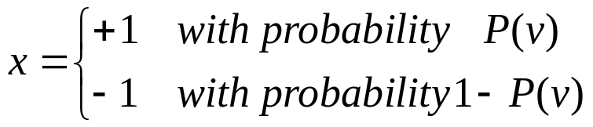
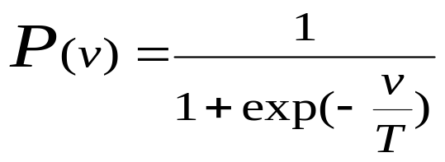
Stochastic Model of a Neuron
Deterministic vs stochastic
stochastic : stay at a state with probability
  x: state of neuron
    v: induced local field
    P(v) probability of firing
        where T is pseudo temperature
        T → 0, reduced to deterministic form

